Slide 1


DSC 425
Time Series Analysis of Power Consumption
Dr. John McDonald
Group – 3 (Power)
Akanksha Singh
Yashkumar Prajapati
Notes:
https://www.kaggle.com/datasets/fedesoriano/electric-power-consumption

Slide 2
OBJECTIVE
Rising Electricity Demand
Weather Influence
High Energy Dependence
Rapid Urban Expansion
Notes:
On global electricity demand growth: the International Energy Agency (IEA) reports that global electricity demand grew by about 2.7 % annually on average (2010-2023) and is projected at ~3.3-3.7 % in 2025-26. IEA+2IEA+2
On weather (temperature / humidity) explaining a large share of electricity load variability: one study indicates that temperature (and implicitly humidity) explains between 25% and 70% of variability in urban electricity consumption. sciencedirect.com
Rising Electricity Demand
Rapidly increasing consumption driven by population growth and expanding commercial activity.
Accurate forecasting is essential to prevent overloads, reduce outages, and maintain service quality.
Strong Weather Sensitivity
Consumption varies significantly with temperature, humidity, and seasonal changes.
Understanding weather–load relationships helps anticipate summer peaks and winter variations.
National Energy Vulnerability
Morocco relies heavily on imported fuel since the refinery shutdown (2015).
Efficient demand management reduces import costs and supports energy security.
Urban Expansion & Infrastructure Pressure
Growing households, industrial zones, and public services increase the load on local networks.
Time-series insights help determine where and when grid reinforcements are needed.
By 2050, about 68% of the global population will live in cities (United Nations).
Weather Influence
Weather explains up to 70% of load variation: Energy journal study, ScienceDirect, Impact of temperature on electricity consumption
Rising Demand
Global electricity demand (~2.5–3% annual growth): International Energy Agency (IEA), Global Energy Review.
Energy Dependency

Slide 3
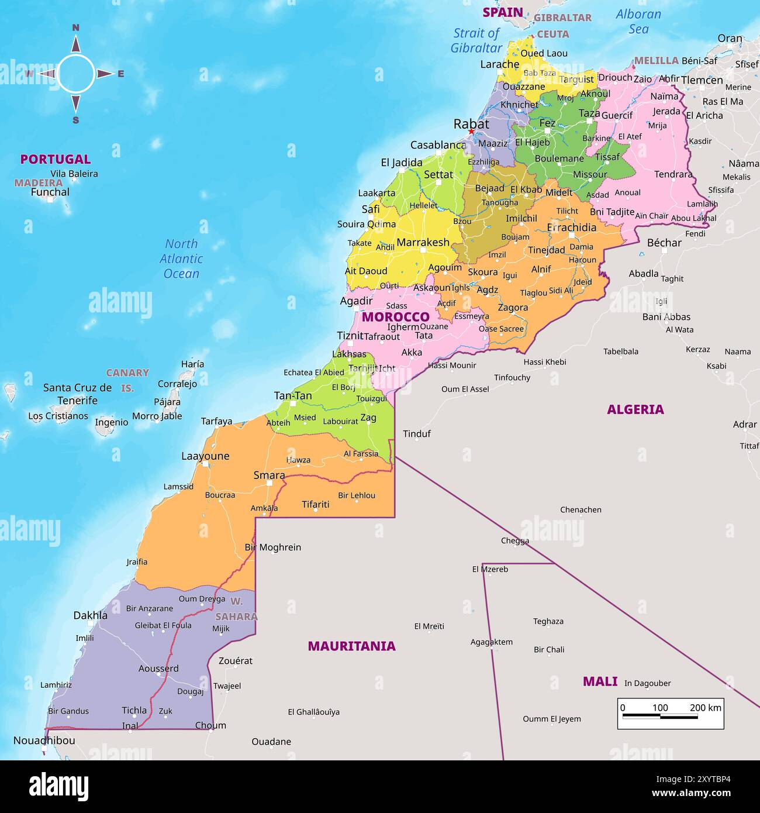
DATASET OVERVIEW
Observations
52416
9
Features
Frequency
10 Minutes
Intervals
Data Range
1 Jan 2017 - 30 Dec 2017

Slide 4
Modelling Strategy Overview
Power Consumption
Daily (aggregated data)
ARIMA
SARIMA
10 minutes (raw data)
VAR + ARMA - GARCH
Fourier Terms + Exogenous Regressors (Temperature)

Slide 5
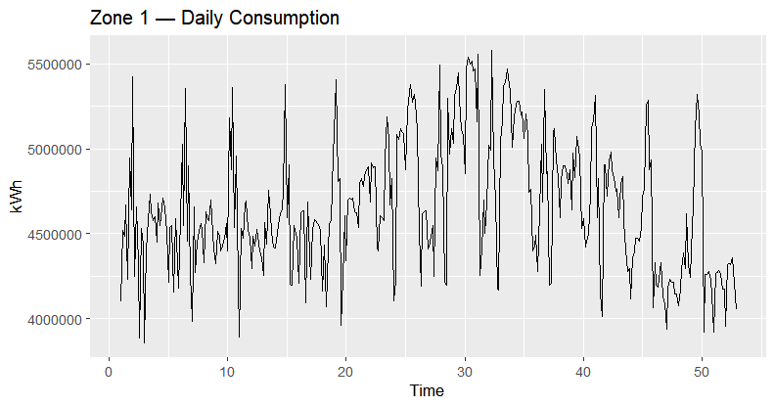
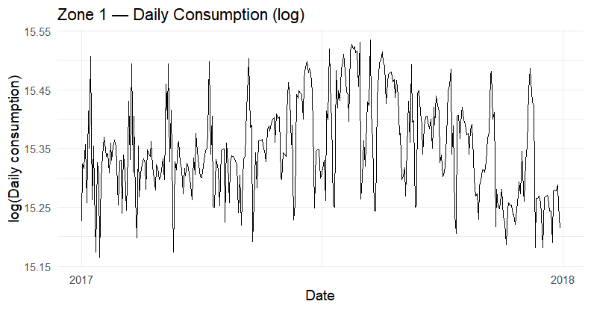
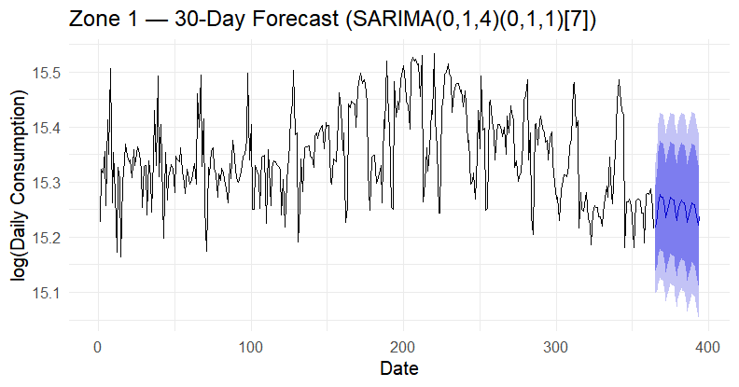
Baseline Modelling Using Daily Aggregation - SARIMA
Model | AICc (approx.) | BIC (approx) | Residual Diagnostics (Ljung-Box p-value)
ARIMA(0,1,1) | −949 | −941 | 9.4e-07 (fails)
ARIMA(1,1,1) | −983 | −972 | 0.0105 (fails)
ARIMA(0,1,2) | −954 | −942 | 2.2e-06 (fails)
ARIMA(0,1,1) + drift | −947 | −935 | 9.4e-07 (fails)
Best ARIMA via AICc/BIC (0,1,4) | −999 | −980 | 0.83 (passes)
SARIMA(0,1,4) (0,1,1)[7] | −963 | −940 | 0.91 (passes)

Slide 6
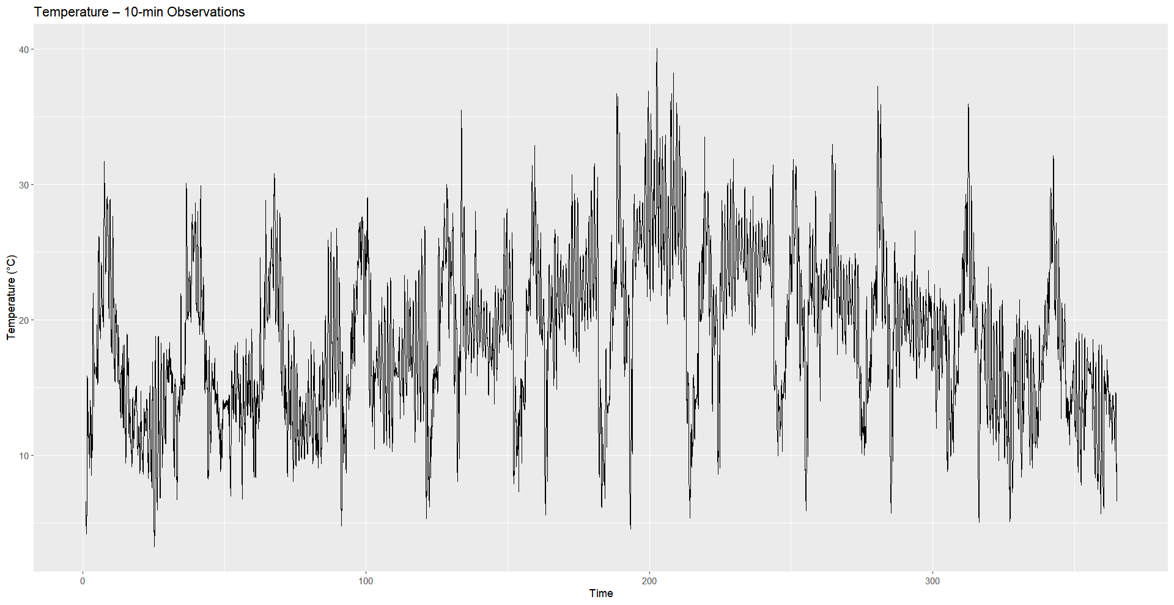
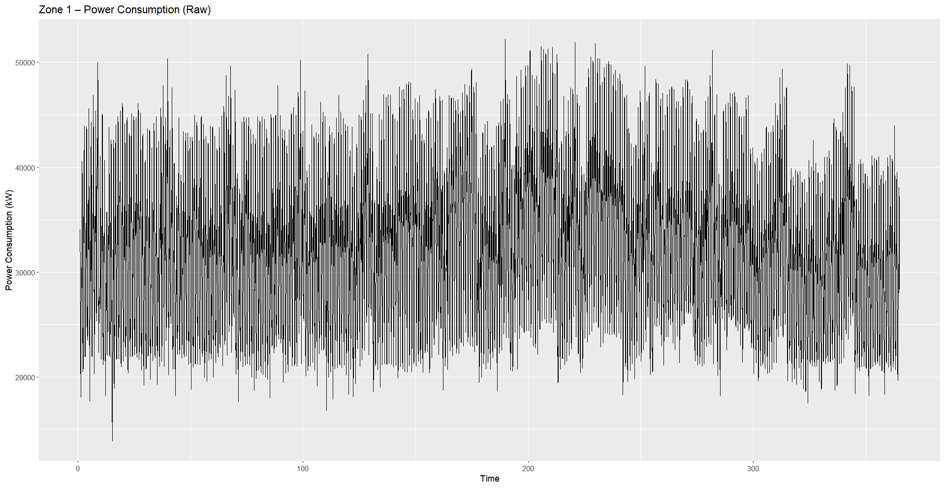
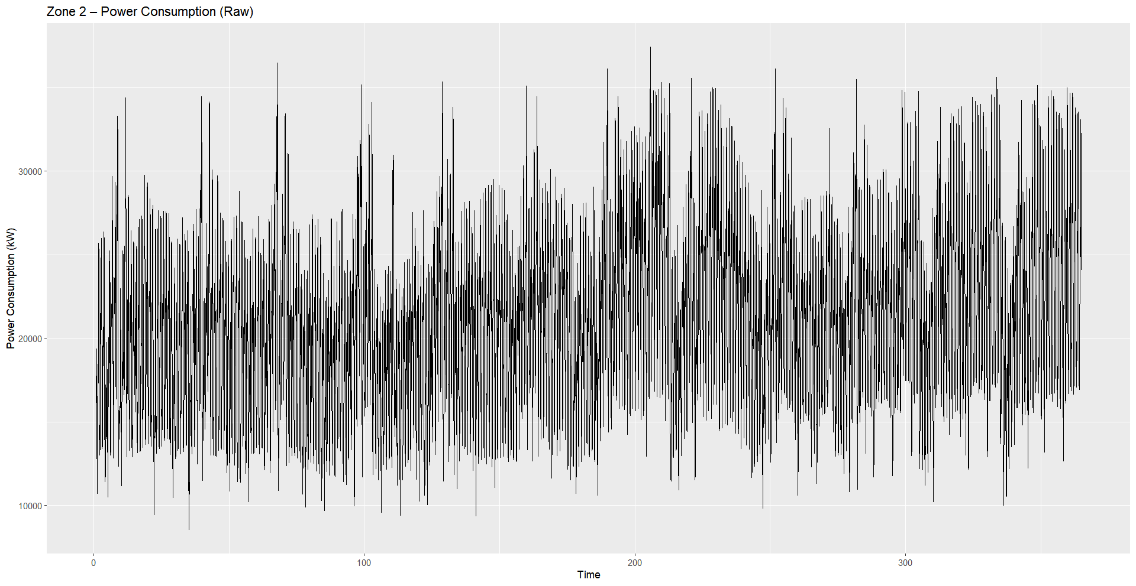
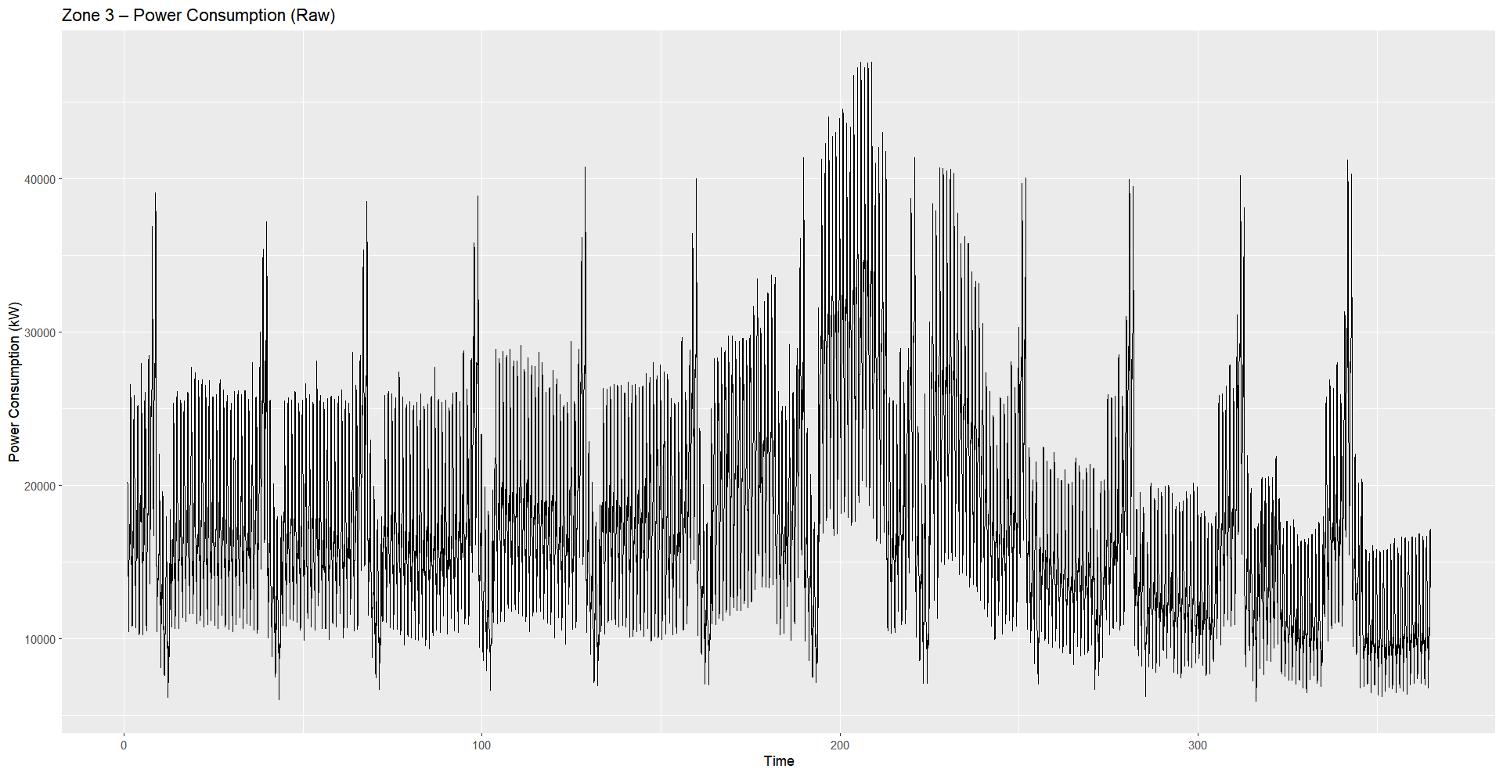
EDA
Raw Time Series Overview

Slide 7
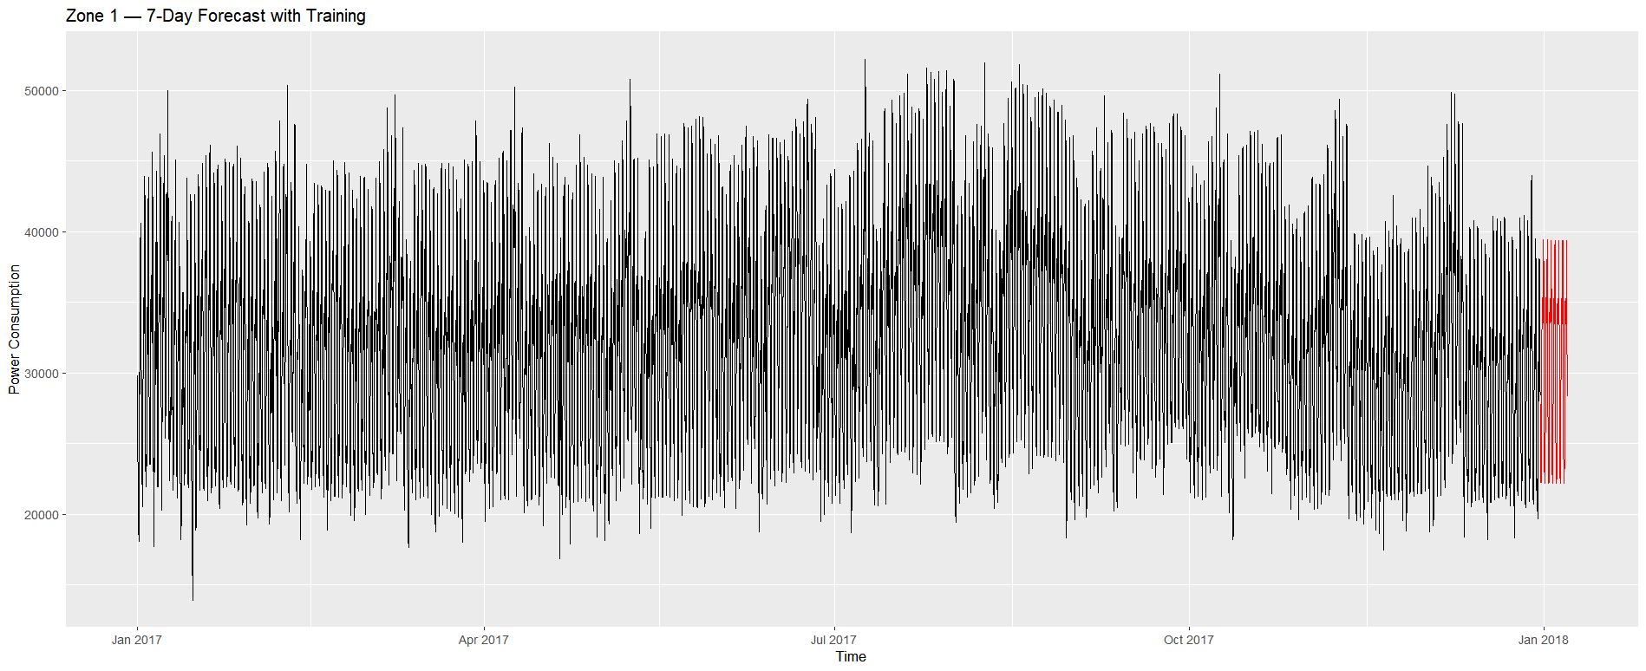
High-Frequency VAR + ARMA–GARCH (10-Minute Data)
Model | Information Criteria / IC Selections | Residual Serial Correlation | Heteroskedasticity (ARCH) | Key Interpretation
VAR(10) | SC selected p = 10 AIC → 24 HQ → 23 SC → 10 | Fail — Portemanteau χ² ≈ 50, df =8, p ≪ 0.001 | Fail — ARCH χ² ≈ 7022, p ≪ 0.001 | VAR(10) still leaves autocorrelation and strong ARCH patterns.
VAR(24) | AIC selected p = 24 HQ → 23 SC → 10 FPE → 24 | Fail — Portemanteau χ² ≈ 7677, df =480, p ≪ 0.001 | Fail — ARCH χ² ≈ 6913, p ≪ 0.001 | Longer-lag VAR does not resolve autocorrelation or volatility.
ARMA(1,1)–GARCH(1,1) (Baseline, skew-t, Fourier K=6) | AIC = −6.037 BIC = −6.0336 | Fail — LB on z: χ² ≈ 758, p ≪ 0.001 | Pass — LB on z²: p ≈ 1 | Good variance modeling, mean autocorrelation remains.
ARMA(3,3)–GARCH(1,1) (Final, skew-t, Fourier K=6) | AIC = −6.0387 BIC = −6.0346 | Fail — LB on z: χ² ≈ 733, p ≪ 0.001 | Pass — LB on z²: p ≈ 1 | Lowest AIC; strong volatility fit; mean still autocorrelated.

Slide 8
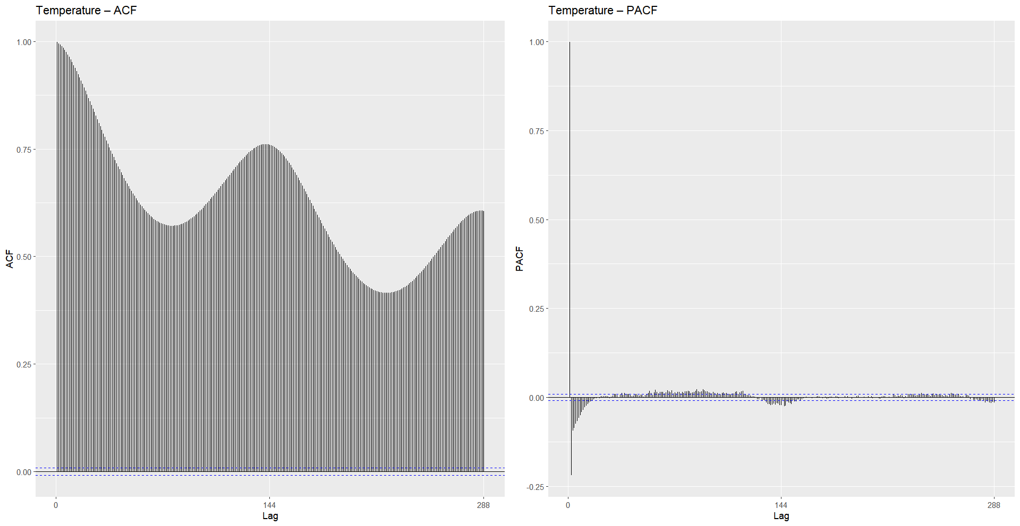
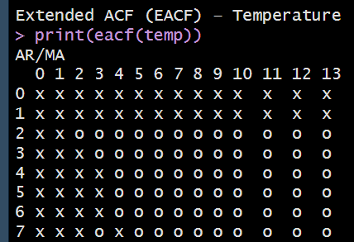
Temperature - Dependence & Stationarity Checks
ADF: pass (stationary in differences) KPSS: fails (not level-stationary)
Strong daily cycle
Smooth, persistent autocorrelation
Good candidate as exogenous regressor
Notes:
“When we broke down the temperature series, the ACF showed a very slow decay with clear waves at the 144-lag mark, which matches a strong daily pattern in the weather. The PACF drops off quickly, meaning there isn’t much short-term autoregressive structure beyond that daily cycle. And the EACF grid basically confirmed the same thing — there’s no clean ARMA shape here. The takeaway for us was that temperature is a smooth, highly seasonal driver, not a noisy one, so it’s better treated as a regressor rather than something needing its own complex ARMA modeling.”

Slide 9
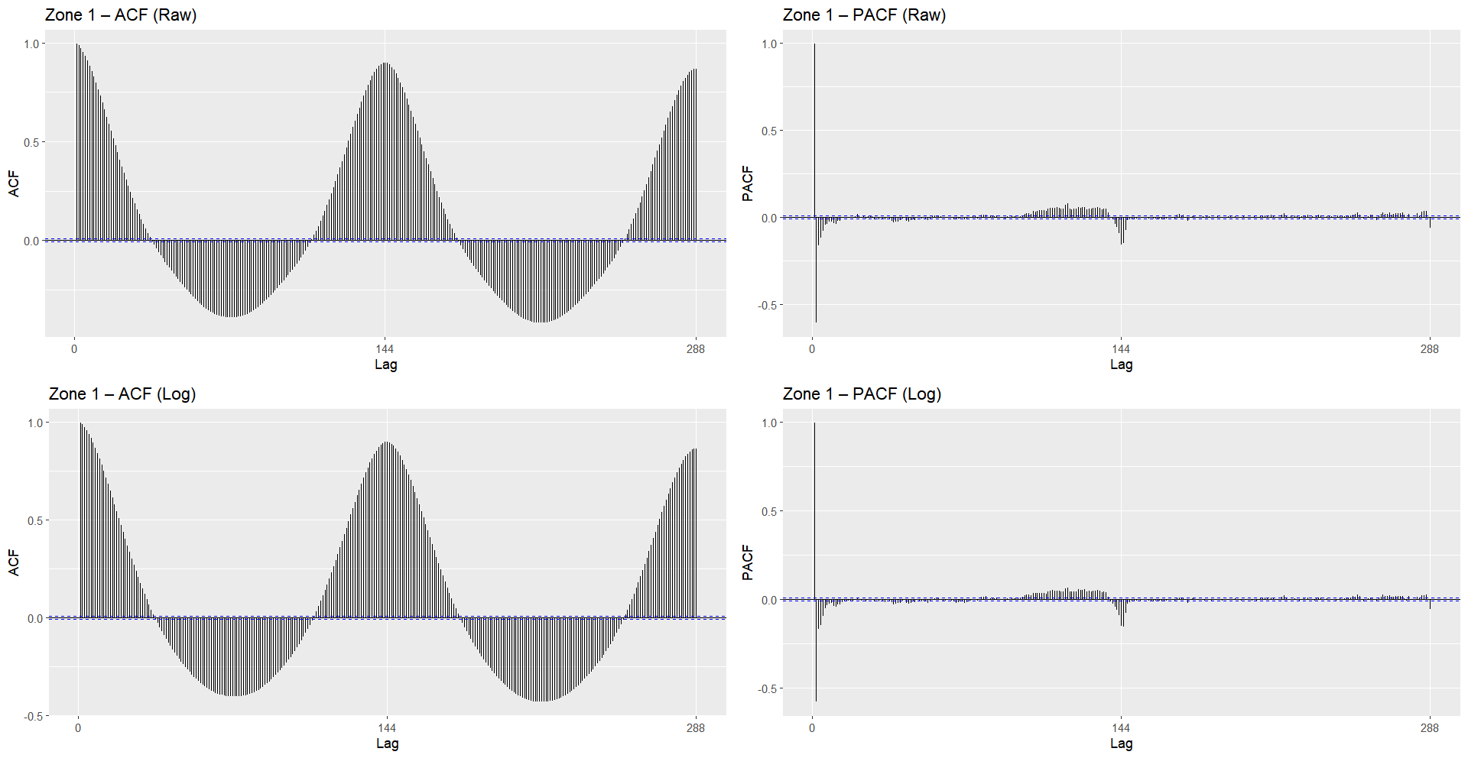
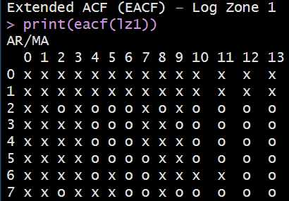
Zone 1 – Dependence & Stationarity Checks
ADF: pass (stationary in differences) KPSS: fails (not level-stationary)
Strong intraday seasonality
Slow decay autocorrelation
Needs seasonal adjustment

Slide 10
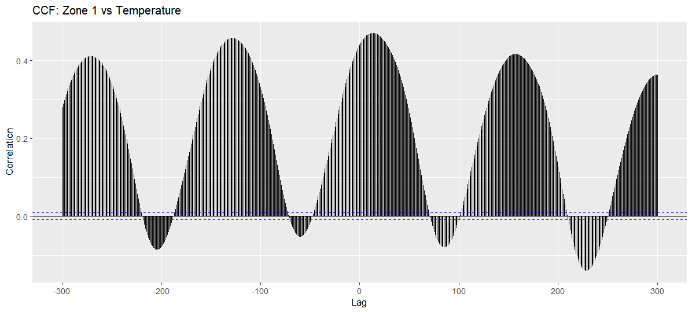
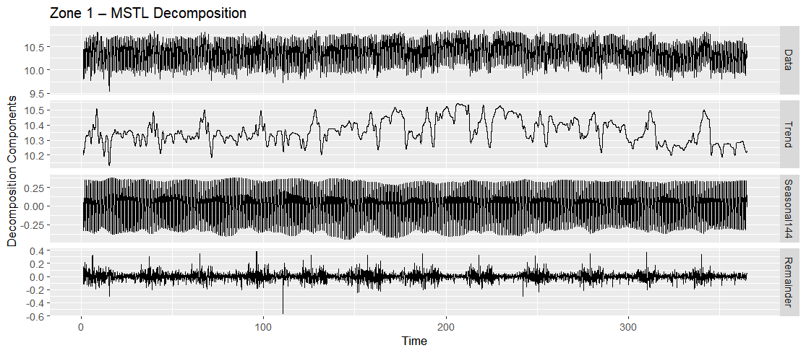
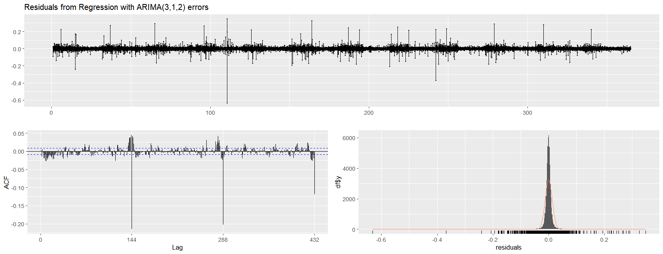
Zone 1: CCF, MSTL, and Model Fit Diagnostics
CCF with Temperature: clear repeating co-movement
MSTL: dominant intraday cycle; small trend
Model Form: ARIMA(3,1,2) + Fourier + Temperature
Residuals: centred; variance stable; mild seasonal autocorrelation remains
Model Selection
• AICc lowest among tested structures
• Fourier terms capture daily shape
• Temperature improves short-horizon alignment
Notes:
“For Zone 1, we started by checking how temperature interacts with power usage. The CCF on the left shows there is some connection, but it’s quite small. You can see those repeating bumps at the daily rhythm, which means temperature isn’t driving consumption — the daily routine is. People use power in Zone 1 in a very patterned way, and weather only nudges that pattern a little.
On the right, the MSTL decomposition made the structure even clearer. The raw line at the top looks messy, but once it’s broken down you see the story:
– the trend barely moves,
– the seasonal component is almost perfectly consistent every single day,
– and the remainder is tiny bursts of noise.
That told us Zone 1 is basically a clean, predictable daily cycle with no strong long-term drift.
Based on that structure, the model that ended up fitting best here was an ARIMA(3,1,2). It’s a simple model, but it captures that repeating pattern while still adapting to small shifts from day to day.
And you can see that in the diagnostics at the bottom: the residuals stay tightly around zero, the ACF looks almost flat, and the distribution is extremely narrow. That’s what you want to see — it means the model has absorbed the daily pattern, and the leftover noise is just random.
So this slide essentially confirmed two things for Zone 1: the behavior is highly routine, and a moderately flexible ARIMA model was all we needed to track those small variations around a stable daily cycle.”

Slide 11
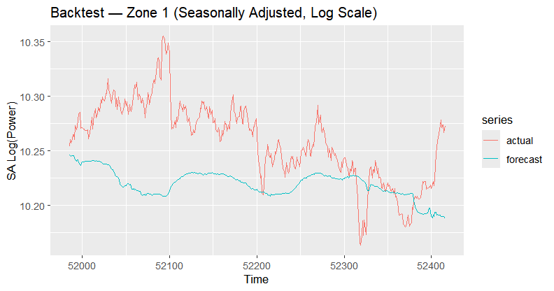
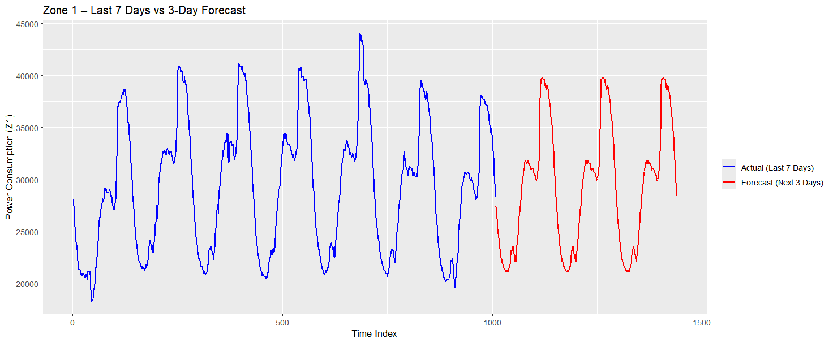
Zone 1 — Back-test Accuracy and 3-Day Forecast
Back-test Accuracy (Seasonally Adjusted, Log Scale): • RMSE: 0.05299 • MAE: 0.04404 • MAPE: 0.43%
Model Behavior:
Captures intraday cycle reliably
Forecast follows overall shape but smooths sharp drops
Daily pattern recovered; level shifts under-tracked
Final Takeaway:
Strong short-horizon pattern accuracy
Limited capability for sudden load changes
Sufficient as a pattern forecaster, not a level-change predictor
Notes:
“For Zone 1, the backtest shows that our 10-minute model — using Fourier seasonality and temperature — tracks the overall intraday movement really well. The fitted line is smoother than the raw data, but it keeps the correct shape the whole time, which tells us the model isn’t drifting or missing major shifts.
In the 3-day forecast on the right, you can see the strength of this approach: the model repeats the intraday cycle almost perfectly. The peaks and drops happen at the right hours, and the amplitude is realistic.
So the main takeaway for Zone 1 is that the intraday pattern completely dominates the behavior, and once the model learns that 24-hour cycle, it produces very stable and reliable short-term forecasts.”

Slide 12
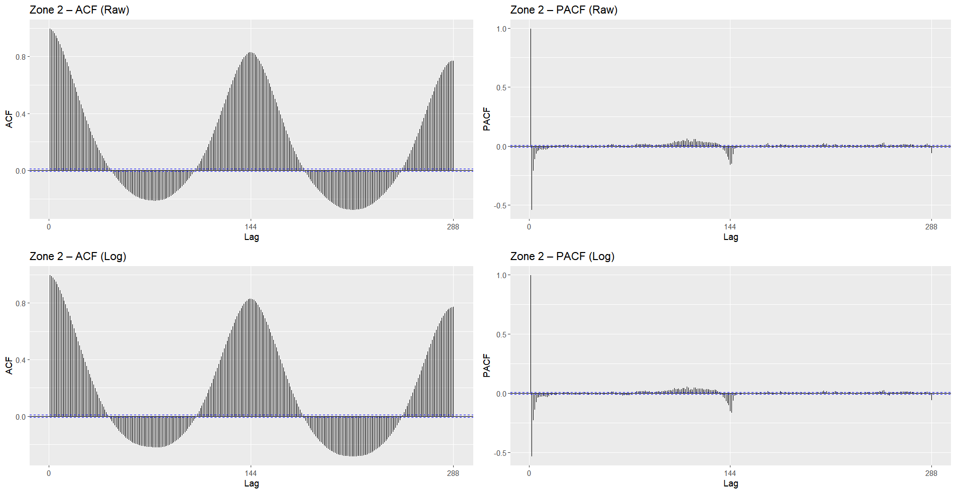
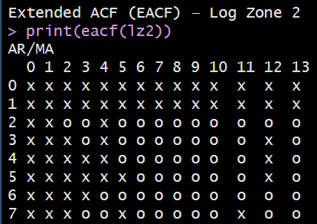
Zone 2 – Dependence & Stationarity Checks
ADF: pass (stationary in differences) KPSS: fails (not level-stationary)
High seasonal persistence
Long memory behavior
Requires seasonal removal

Slide 13
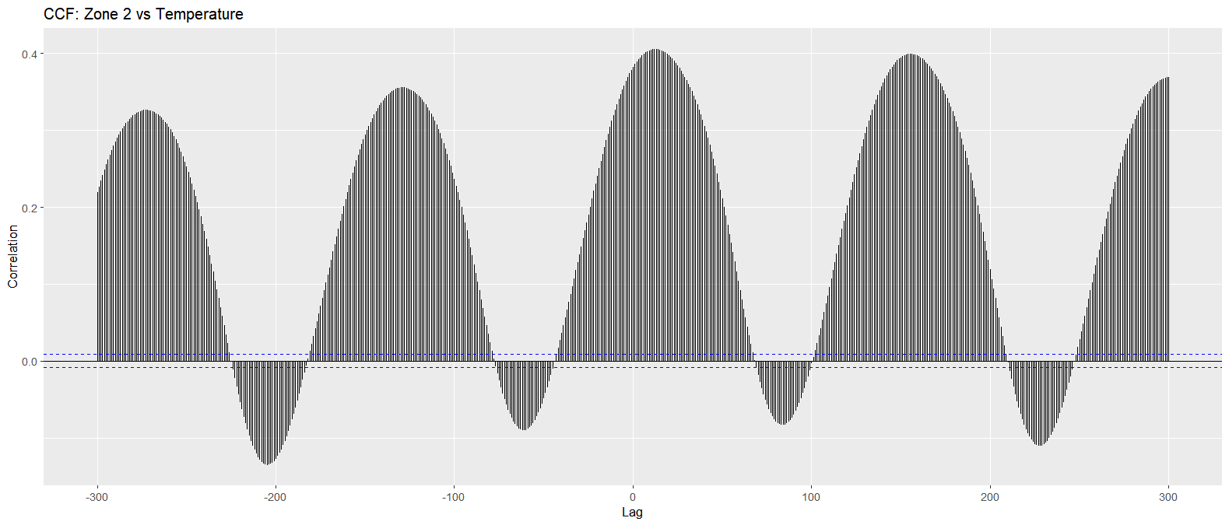
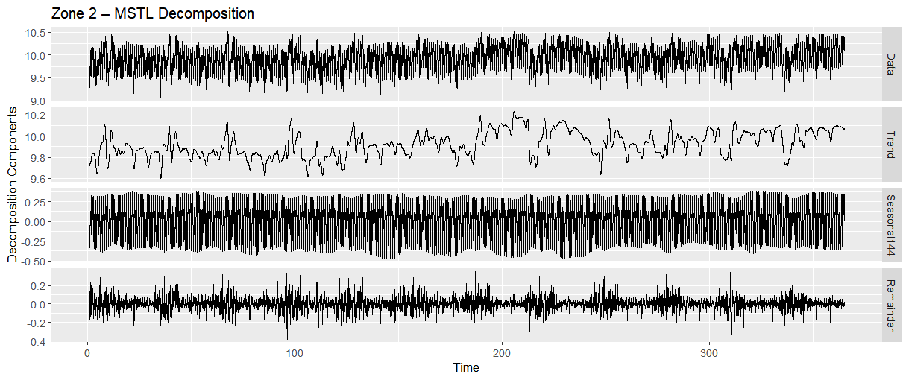
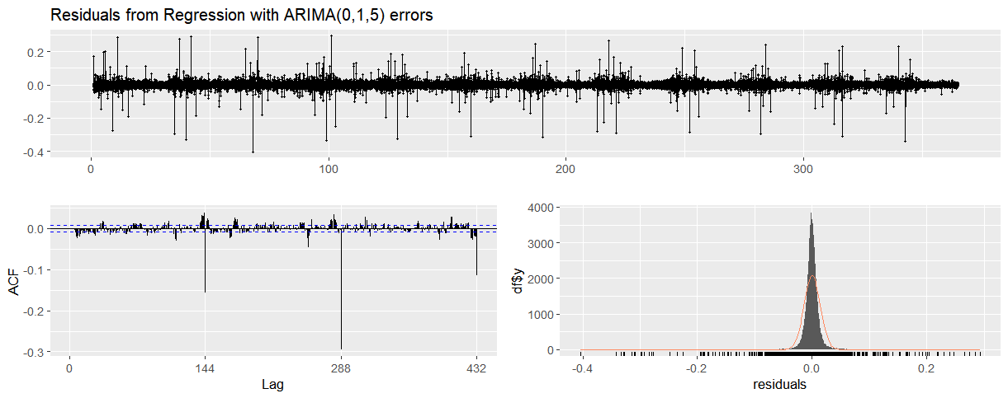
Zone 2: CCF, MSTL, and Model Fit Diagnostics
CCF with Temperature: clear repeating cycle; moderate co movement
MSTL: strong 144-point intraday seasonality; mild trend drift Model Form: ARIMA(0,1,5) + Fourier + Temperature Residuals: centred; variance stable; small seasonal autocorrelation remains
Model Selection:
Best AICc among candidate Zone 2 structures
MA-dominant pattern aligns with EACF shape
Fourier terms handle daily cycle; temperature improves short-term fit
Notes:
“For Zone 2, the CCF with temperature shows a very strong seasonal relationship. The peaks repeat almost perfectly every 144 lags, meaning temperature and demand rise and fall together over the daily cycle rather than at a single fixed lag.
The MSTL decomposition makes this even clearer. Zone 2 has one of the cleanest daily seasonal patterns in the whole dataset. The trend moves slowly with small weekday–weekend waves, and the remainder is tight with only occasional bursts from short-term usage shifts. This fits the nature of Zone 2, which mixes residential and commercial activity — predictable routine, but a bit of variation in intensity.
The residual diagnostics from our Fourier + ARIMA-error model confirm this structure. The residuals stay centered around zero, the ACF is nearly flat, and the histogram is sharply peaked, which means the model captured most of the systematic daily behavior and left behind only minor noise.
Overall, Zone 2 behaves as a stable, highly seasonal zone with moderate temperature influence, and it ends up being one of the easier zones to model reliably.”

Slide 14
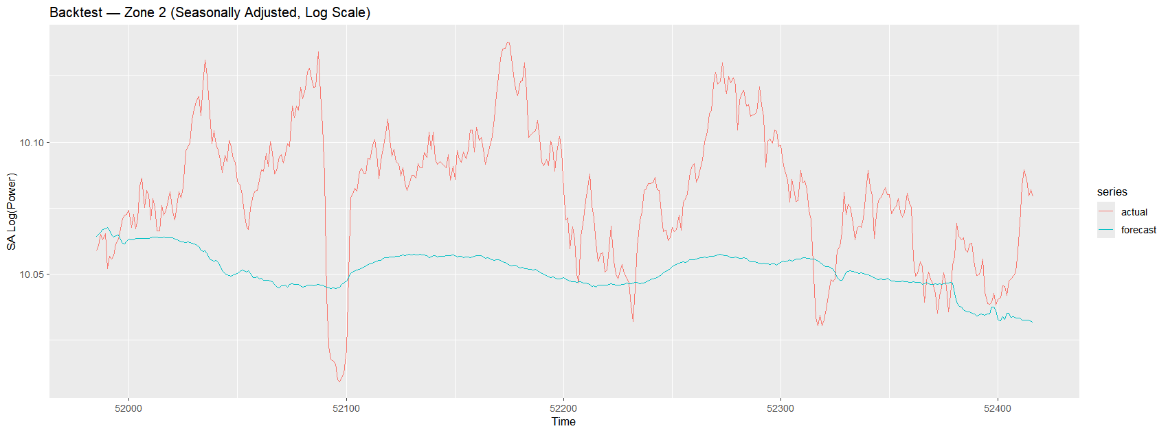
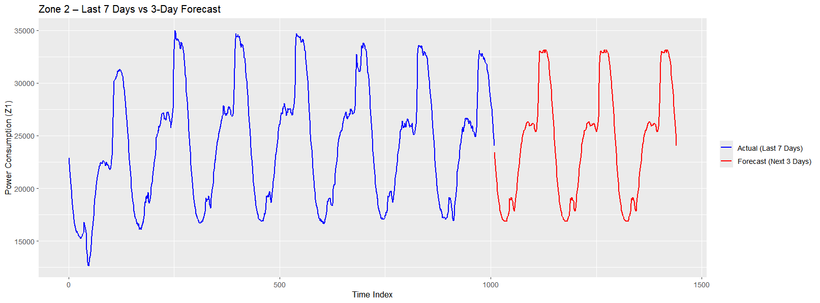
Zone 2 — Back-test Accuracy and 3-Day Forecast
Back-test Accuracy (Seasonally Adjusted, Log Scale): • RMSE: 0.03831 • MAE: 0.03247 • MAPE: 0.32%
Model Behavior: • Recovers intraday cycle consistently • Forecast tracks the general pattern but stays smoother • Underestimates sharp rises and dips in demand
Final Takeaway:
Reliable short-horizon cycle prediction
Weak on sudden consumption changes
Performs well as a pattern-focused forecaster, not a peak-level predictor
Notes:
“For Zone 2, the backtest shows that our 10-minute Fourier model follows the overall movement well, even though this zone has slightly sharper jumps than Zone 1. The fitted line stays smoother than the raw data but continues to track the direction correctly, which is what we expect — Zone 2 has mixed residential and commercial load, so the intensity shifts day to day, but the underlying intraday rhythm stays stable.
In the 3-day forecast, that rhythm shows up very clearly. The peaks and drops happen at the right hours, and the shape of the daily curve matches the last week almost exactly. The model doesn’t chase every spike, but it captures the actual intraday cycle very reliably.
So overall, Zone 2 gives us a clean, repeatable daily pattern with a bit more variability, and the model handles that balance really well.”

Slide 15
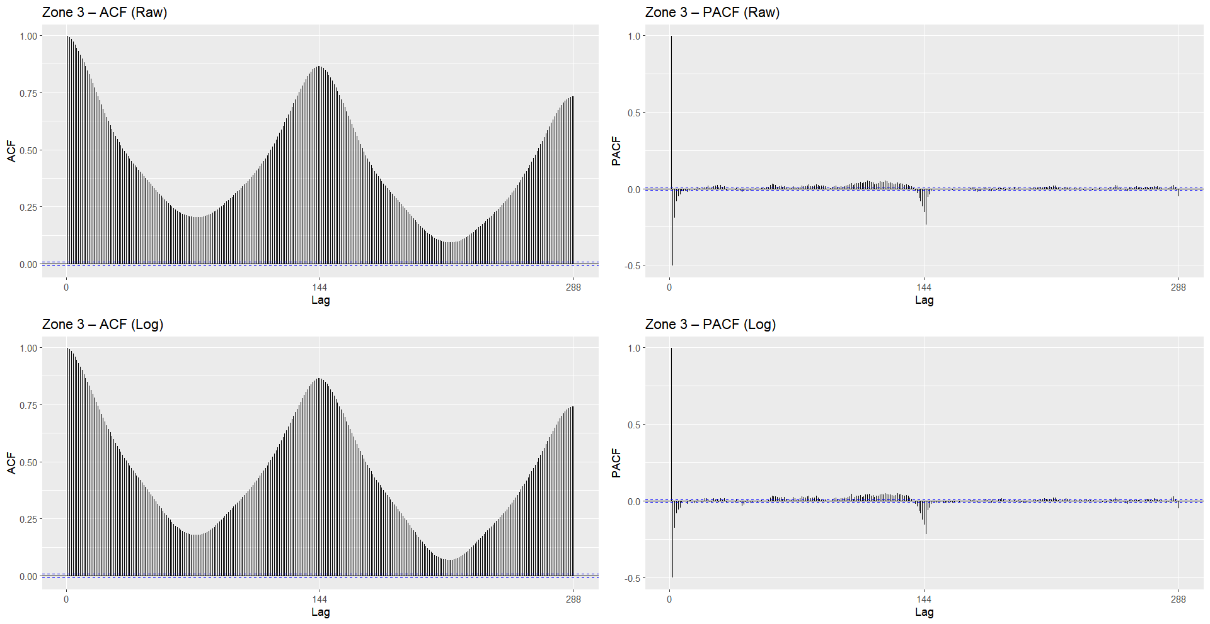
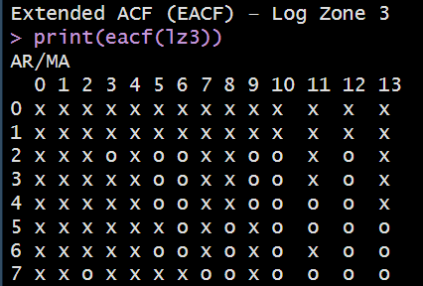
Zone 3 – Dependence & Stationarity Checks
ADF: pass (stationary in differences) KPSS: fails (not level-stationary)
Most volatile zone
Deep seasonal structure
MA-dominant pattern

Slide 16
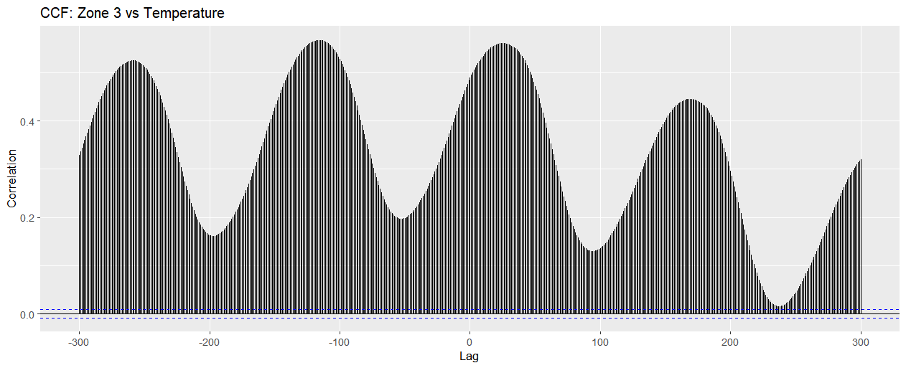
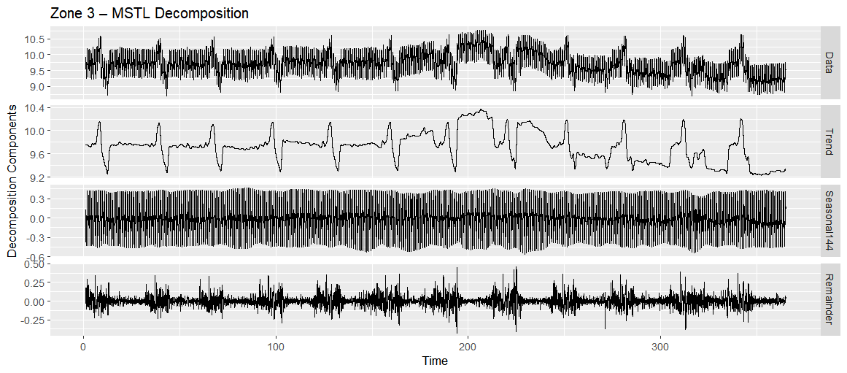
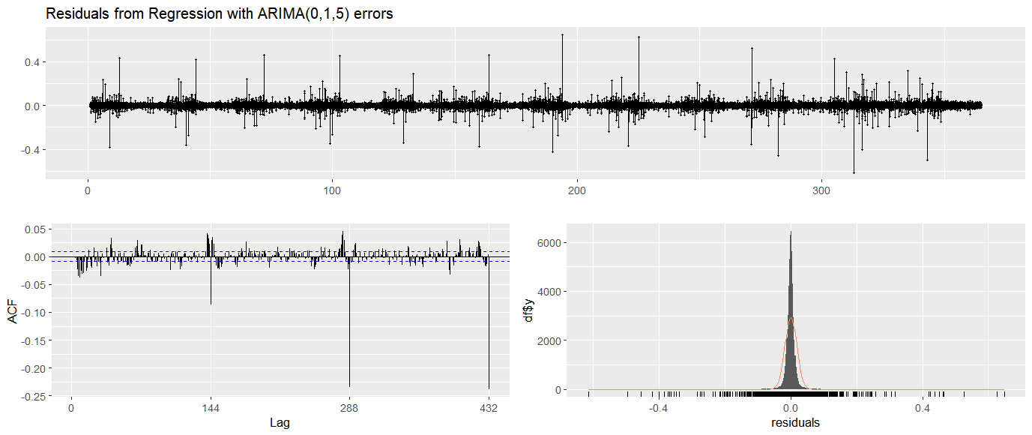
Zone 3: CCF, MSTL, and Model Fit Diagnostics
CCF with Temperature: repeating high-amplitude cycle; strongest temperature link
MSTL: clear intraday seasonality; trend more irregular than Z1/Z2
Model Form: ARIMA(0,1,5) + Fourier + Temperature
Residuals: centred; variance stable; seasonal lags still visible
Model Selection
Lowest AICc among Zone 3 candidates
MA-dominant remainder matches EACF pattern
Fourier captures daily structure; temperature improves short-horizon response
Notes:
“For Zone 3, the CCF shows the same repeating daily pattern as the other zones, but with much stronger peaks. That means temperature affects this zone more directly, which matches what we see operationally — Zone 3 has more industrial‐type loads that respond sharply to heat.
The MSTL decomposition confirms this: the daily seasonal component is still dominant, but the remainder is much noisier, with frequent spikes that break the smooth rhythm. The trend also shifts more, showing short, irregular operational changes.
Our Fourier + ARIMA(0,1,5) model captured the main daily cycle, but the residuals show more volatility left over compared to the other zones. So Zone 3 is still highly seasonal and temperature-sensitive, just much more unpredictable, which makes it the hardest of the three to model cleanly.”

Slide 17
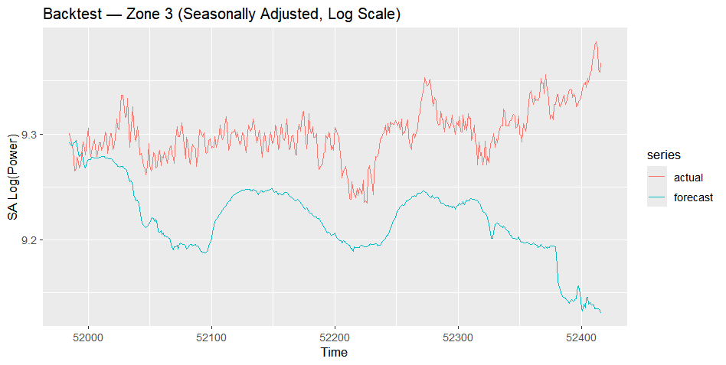
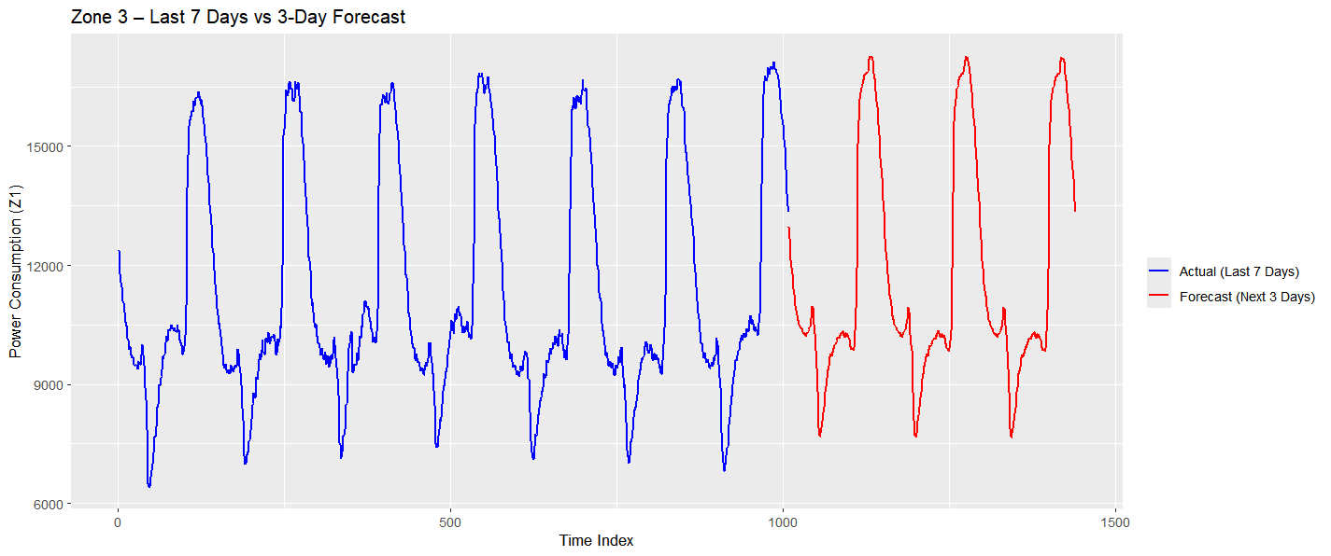
Zone 3 — Back-test Accuracy and 3-Day Forecast
Back-test Accuracy (Seasonally Adjusted, Log Scale): • RMSE: 0.04122 • MAE: 0.03490 • MAPE: 0.37%
Model Behavior: • Daily cycle captured with consistent timing • Forecast stays smoother than true consumption • Underestimates sharp peaks and sudden load changes
Final Takeaway:
Strong short-term seasonal pattern recovery
Limited handling of abrupt demand spikes
Effective for cycle prediction, not for level-shift or volatility forecasting
Notes:
“For Zone 3, the backtest highlights the two things that make this zone different: it follows the same intraday cycle as the others, but it also has large, sudden jumps that look more like operational switches. The model tracks the general shape but smooths those abrupt spikes, which is expected — they’re not predictable time-series behavior, they’re one-off shifts in demand.
In the short-term forecast, the daily pattern is captured very accurately. Zone 3 rises sharply during active hours and drops hard at night, and the model repeats that timing almost perfectly. What changes is the amplitude — the peaks go much higher and the troughs dip lower than in the other zones — and the forecast reflects that without overreacting.
So even though Zone 3 is the most volatile zone, the model still gives a reliable intraday curve for the next few days, which is exactly what’s needed for short-term planning.”

Slide 18
Challenges Encountered
Structural limitations of the dataset
Time and frequency structure problems
Daily aggregation wiped out essential signal
Autocorrelation far stronger than standard models assume
Multivariate modeling instability
Exogenous and seasonal components were difficult to extract cleanly

Slide 19
Key Learnings
High-frequency data behaves fundamentally differently
Strong autocorrelation dominates model behavior
Seasonality is multi-layered, not single-cycle
Aggregation can destroy critical information
Exogenous signals may be weak even if correlated
Classical models struggle with sudden level shifts
Multi-step forecasting amplifies uncertainty

Slide 20
Conclusion
Our analysis showed that reliable forecasting for this dataset is only achievable when the model directly captures the strong intraday seasonal structure. Daily ARIMA/SARIMA and VAR-GARCH approaches struggled with the extreme autocorrelation and high-frequency volatility. The Fourier + Exogenous Regressor model produced the most stable short-term results by learning the 10-minute cycle, though it still smoothed sharp level shifts. Overall, the project established a solid baseline forecaster and clarified the limits of classical time-series methods for dense, operational load data.

Slide 21
Future Work
Extend dataset to multiple years to capture annual and long-term seasonal structure
Incorporate additional exogenous drivers (holidays, operational schedules, regional demand)
Explore machine-learning and hybrid models (LSTM, TFT, Prophet + ARMA residuals) for regime shifts

Slide 22
Thank You
😊

